Slide 1
State and International Law

Slide 2
As the state was recognized as main entity in the Treaty of Westphalia, many nationality tried to achieve state.
Convention on the Rights and Duties of States (held in Montevideo) 1993 defined that a state shd possess:
A) A permanent population
B) a defined territory
C) government (an affective government)
D) Capacity to enter relations with other states
E) Independence and Sovereignty https://www.youtube.com/watch?v=iGiqWhUIppo

Slide 3
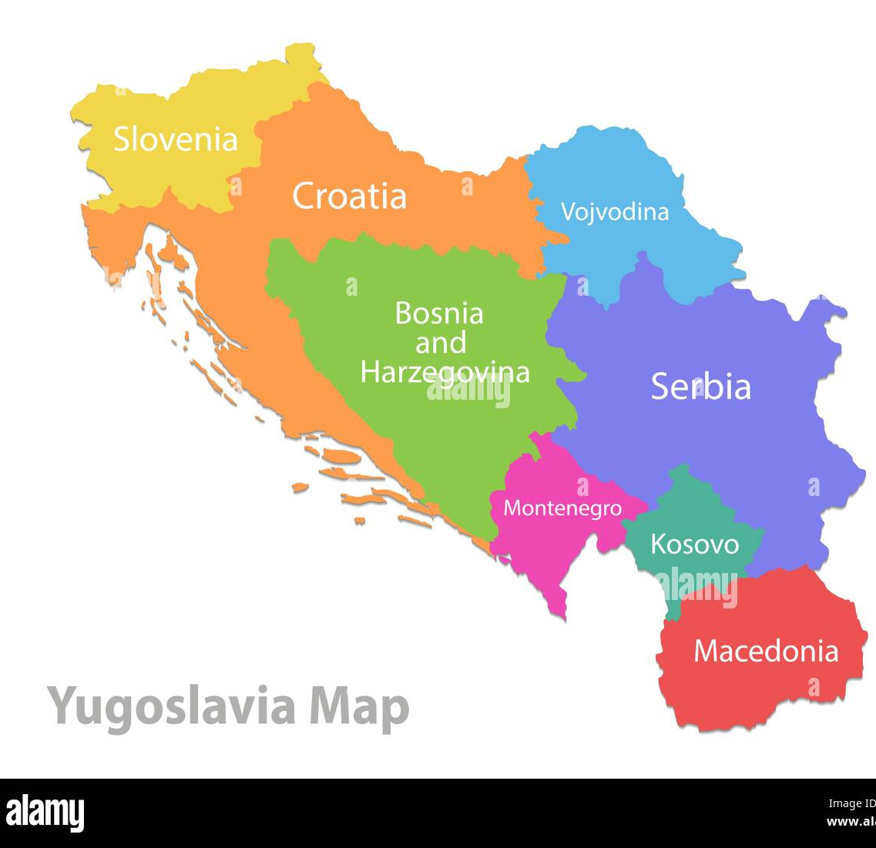
Formation of state in IL
IL does not consider State as permanent entity (“state is not static”); it can exist, seize to exist, born and reborn
A) *Secession: (a portion of state secedes from the main state, mostly as a result of upheaval)
*the action of withdrawing formally from membership of a federation or body, especially a political state.
Eg: Creation of Bangladesh, Yogoslavia’s disintegration into six states
B) Succession: (statehood is transferred to a territory

Slide 4
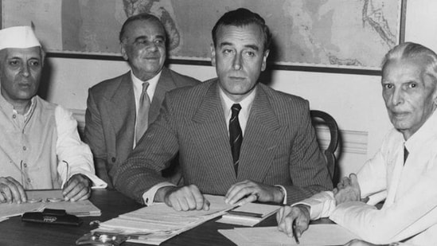
Succession: Succession of State eg Mountbatten's Plan
The June 3 plan announced that India would be splitting into two nations after its independence -- India and Pakistan. The division came into effect on August 15, 1947.
- The plan included the principles of partition and gave autonomy and sovereignty to both India and Pakistan. It also gave the nations the right to form their own constitution.
https://www.hindustantimes.com/india-news/mountbattens-last-plan-for-independence-all-you-need-to-know-about-the-june-3-1947-plan-101622694800571.html

Slide 5
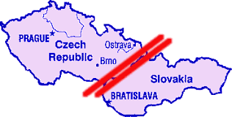
Succession State: Case of Czechoslovakia
Dispute over sharing of resources:
By the 1990s, the Czech Republic's GDP per capita was some 20 percent higher than Slovakia's, but its long-run GDP growth was lower.
Transfer payments from the Czech budget to Slovakia, which had been the rule in the past, were stopped in January 1991.
The state was bifurcated into two by 1993

Slide 6
Self determination under International law
A controversial and contested topic
Started with Woodrow Wilson’s 14 points
“nationalities would have their own states.”
https://www.youtube.com/watch?v=lbdhxLVlrhI
Later reflected in the UN charter Article 1-2
The Purposes of the United Nations are:
1. To maintain international peace and security, and to that end: to take effective collective measures for the prevention and removal of threats to the peace, and for the suppression of acts of aggression or other breaches of the peace, and to bring about by peaceful means, and in conformity with the principles of justice and international law, adjustment or settlement of international disputes or situations which might lead to a breach of the peace;
2. To develop friendly relations among nations based on respect for the principle of equal rights and self-determination of peoples, and to take other appropriate measures to strengthen universal peace;

Slide 7
Self-determination
The opinion is divided over the issue of Self-determination
A section of IL experts believe :
The UN included this to end colonisation (the states which were under colonial subjugation has the right to seek self-determination)
The two consecutive treaties/convention does mention “right to self-determination”
International Covenant on Civil and Political rights (1966)
1. All peoples have the right of self-determination. By virtue of that right they freely determine their political status and freely pursue their economic, social and cultural development. (Article 1)
https://www.ohchr.org/en/instruments-mechanisms/instruments/international-covenant-civil-and-political-rights

Slide 8
International Covenant of Economic, Social, and Cultural Rights (1966)
1. All peoples have the right of self-determination. By virtue of that right they freely determine their political status and freely pursue their economic, social and cultural development.
https://www.ohchr.org/en/instruments-mechanisms/instruments/international-covenant-economic-social-and-cultural-rights

Slide 9
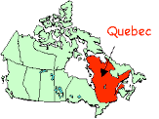
Cases where right to Self-determination were exercised
“Do you agree that Québec should become sovereign, after having made a formal offer to Canada for a new economic and political partnership, within the scope of the Bill respecting the future of Québec and of the agreement signed on 12 June 1995?”
the “no” side achieved victory by a narrow majority of 50.58 percent.

Slide 10
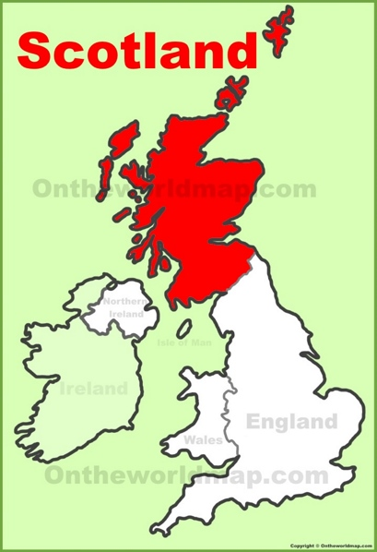
The case of Scotland (2014)
The overall result was slightly wider than predicted with 55% No to 45% Yes but the split varied across areas.
Further reading:
https://constitutionallawmatters.org/2022/07/what-is-the-legal-status-of-a-referendum-and-why-bother-holding-one/

Slide 11
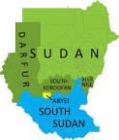
South Sudan
The referendum to determine the status of Southern Sudan was held in January 2011,
An overwhelming majority, 98.83% of participants, voting for independence.

